Slide 1
UNIT 1
Introduction to Analog Electronics Session-2
Characteristics of JFET (Common Source, Common Drain and Common Gate configurations) and uses
Differences between BJT and JFET

Slide 2
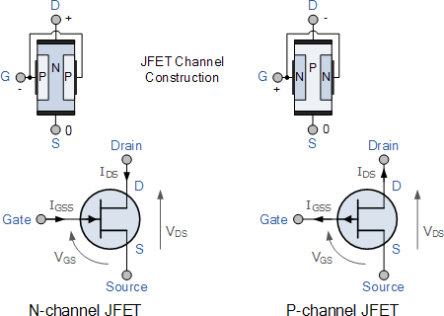
JUNCTION FIELD EFFECT TRANSISTOR (JFET)
BASICS
There are two types of JFET’s:
n-channel and p-channel.
The n-channel is widely used.
Three terminals:
Drain (D) and Source (S) are
connected to n-channel
Gate (G) is connected to the p-type
material.
Gate is always reverse biased
Gate current, I_{D}=0
CONSTRUCTION, TYPES & SYMBOLS
(Image source: www.electronics-tutorials.ws)

Slide 3
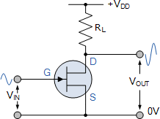
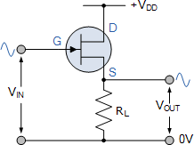
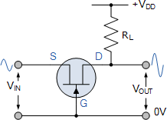
JFET AMPLIFIER-CONFIGURATIONS
BASICS
Common Source (CS) configuration (Good voltage amplifier)
Mostly used, Similar to CE transistor
Generally used in audio frequency amplifiers and in high input impedance
pre-amplifier stages.
Common Drain (CD) configuration (Good voltage buffer)
1
Source follower
High input impedance and a low output impedance
Approx. unity voltage gain-used in buffer amplifiers.
referred to as “Common Drain” because there is no signal available at the drain connection.
2
3. Common Gate (CG) configuration (Good current buffer)
Has a low input impedance, but a high output impedance.
Applied in high frequency circuits or in impedance matching circuits where a low input impedance needs to be matched to a high output impedance
Microphone amplifiers
3

Slide 4
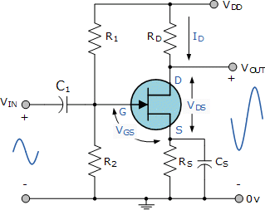
COMMON SOURCE AMPLIFIER
BASICS
In CS configuration, the input is given to the gate and the output is taken from the drain.
180 degree phase shift between input
and output.
Features
Large voltage gain
Good voltage amplifier
Better transconductance amplifier
High input resistance
Medium / high output resistance

Slide 5
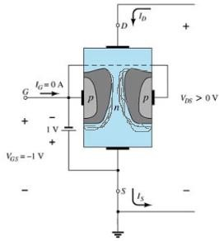
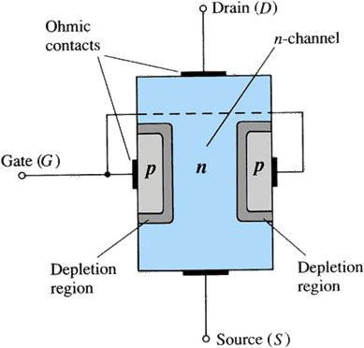
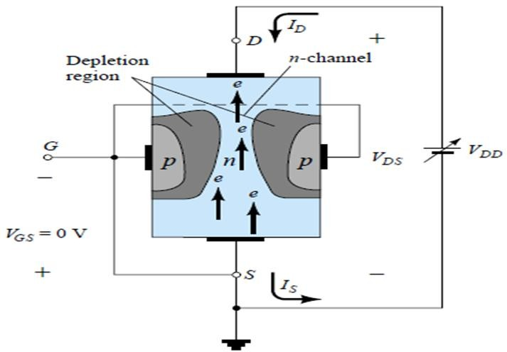
JFET (CS) WORKING
BASICS
The depletion region becomes thicker with
increased reverse bias
When V_{GS} =0
When V_{GS} <0
(Adapted from: Electronic devices and Circuit
theory, Robert L Boylestad and Louis Nashelsky)

Slide 6
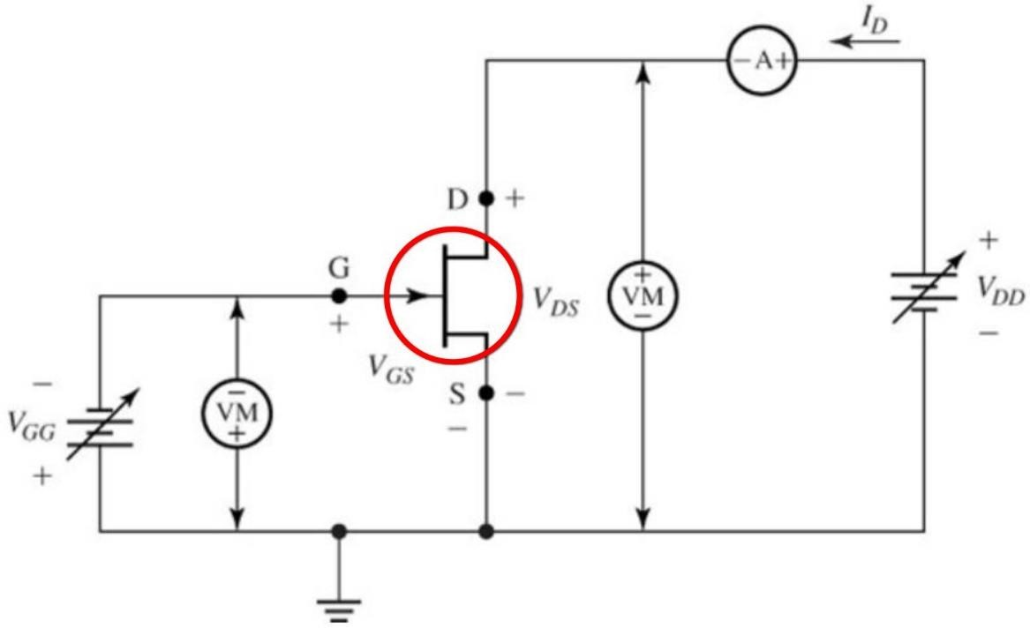
CONNECTION DIAGRAM FOR DETERMINING THE CS AMPLFIER CHARACTERISTICS

Slide 7
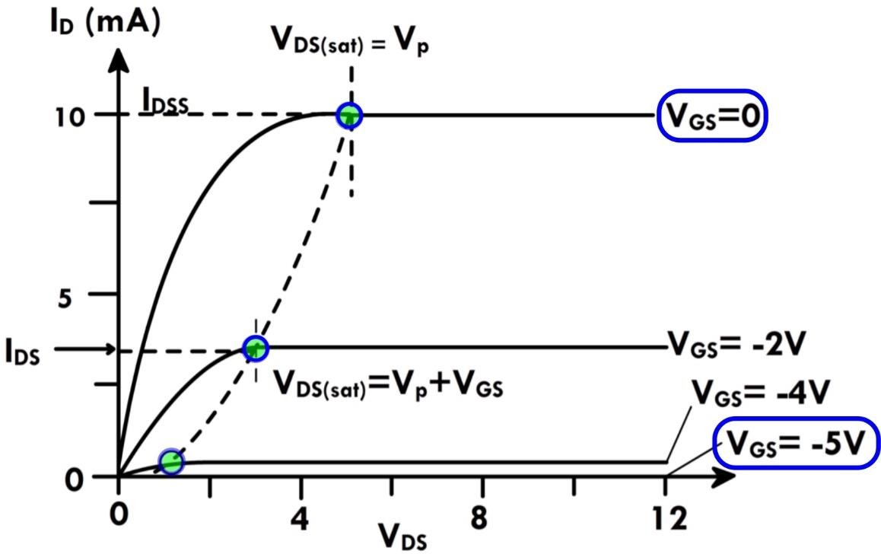
CS AMPLIFIER CHARACTERISTICS
Drain or V-I characteristics
Output characteristics
Relationship between Drain current (I_{D}) and Drain to source voltage (V_{DS}) for different values of gate to source voltage (V_{GS})
I
D
VS V FOR V
= constant
DS
GS
Operation analysis includes
Without external bias: (V_{GS} =0)
With external bias.
^{V}GS
Depletion layer I_{D}.

Slide 8
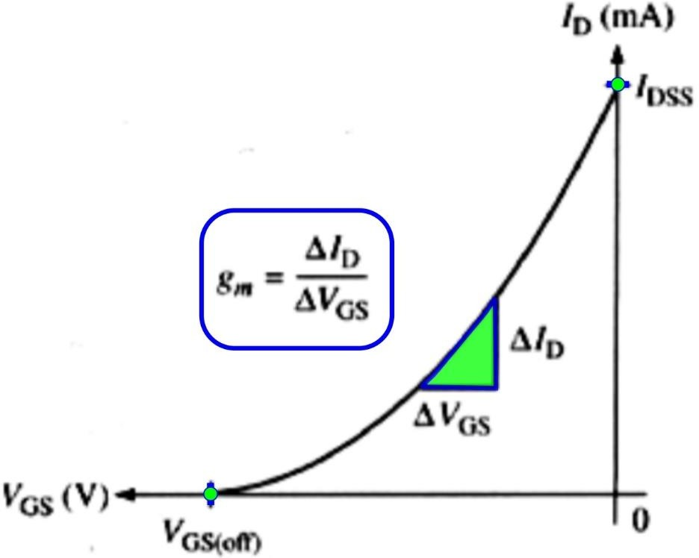

CS AMPLIFIER CHARACTERISTICS
The transfer characteristics
The plot of the drain current Vs gate-source voltage for different values of drain to source voltage (V_{GS})
It is observed that the value of drain current varies inversely with respect to gate-source voltage when the drain-source voltage is constant.
The transfer characteristics is drawn between input voltage and output current.
I_{D} VS. V_{GS} FOR V_{DS} = constant

Slide 9
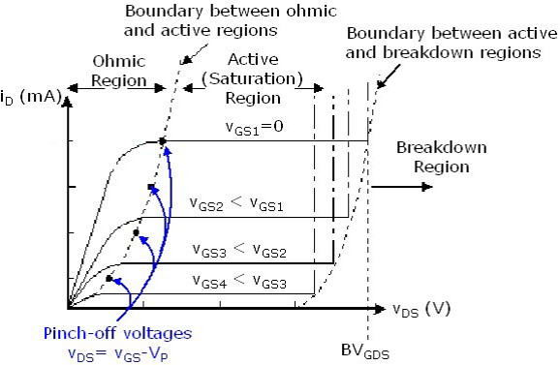
CS AMPLIFIER CHARACTERISTICS
At the pinch-off point,
any further increase in V_{DS} does not
produce any increase in I_{D}.
V_{GS} at pinch-off is denoted as V_{p}.
I_{D} is at saturation or maximum. It is referred
to as I_{DSS}.
(Image source: www.rezzonics.blogspot.com)

Slide 10
CS AMPLIFIER CHARACTERISTICS
Important terms in JFET characteristics
Knee Point: Where the variation of drain current with drain-source voltage appears
to be linear. But beyond this point, the linearity changes into a curve.
Channel Ohmic Region: The region to the left of the knee point in the
characteristics curve.
Pinch-off point: The point in the curve beyond which the drain current will not increase further no matter how much we are increasing the drain to source voltage.
Pinch-off Voltage: The voltage at the pinch-off point is termed as pinch-off voltage because at this voltage, the current is completely turned to be constant.
Drain-Source Saturation Current: The drain to source saturation current is the current which becomes constant and enters into a saturation state.

Slide 11
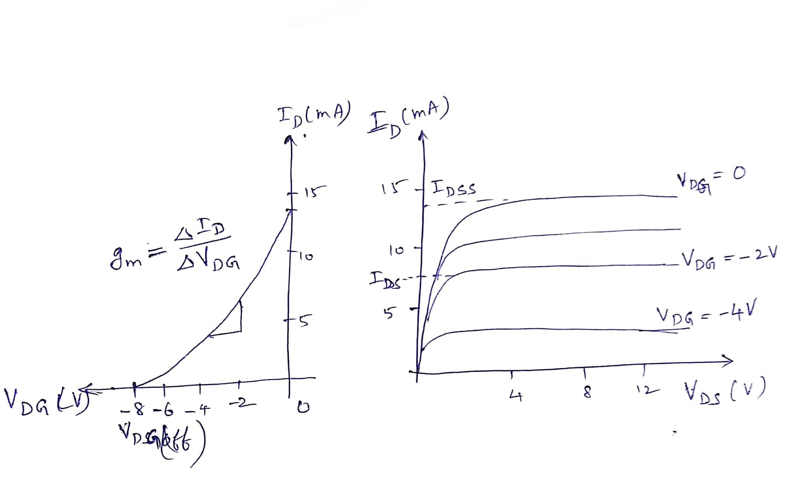
COMMON DRAIN JFET AMPLIFIER (Source follower)
The output characteristics
Connect ammeters to necessary
voltmeters and the and
measure
voltages
currents (as explained in CS
amplifier connections)
The transfer characteristics

Slide 12
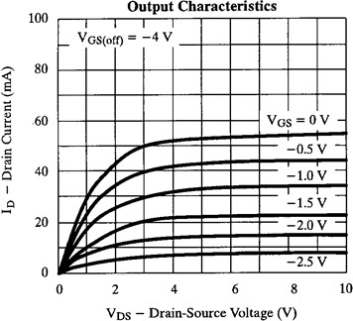
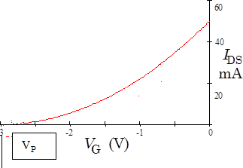
COMMON GATE JFET AMPLIFIER-CHARACTERISTICS
The output characteristics
Connect ammeters to necessary
voltmeters and the and
measure
voltages
currents (as explained in CS
amplifier connections)
The transfer characteristics

Slide 13
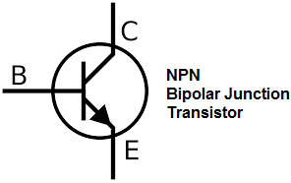
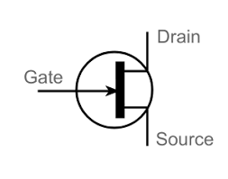
COMPARISON BETWEEN BJT AND JFET
BJT | JFET
Bipolar Device | Unipolar Device
Current Controlled Device | Voltage Controlled Device
Low Input Impedance | High Input Impedance
Consumes more power | Consumes less power
High Noise level | Low noise level
Low thermal stability | High thermal stability
Large size | Small size
Preferred in low current application | Preferred in low voltage application
High gain | Low – medium gain

Slide 14
REVIEW QUESTIONS
Source follower is a circuit that provides
In CS amplifier, the drain-source current is largest when the gate-source
voltage V_{GS} is
Which JFET amplifier configuration is used in microphone amplifiers?
JFET is a controlled device

Slide 15
UNIT 1
Introduction to Analog Electronics
NEXT
Session-3
Transistor Amplifier: CE amplifier
Transistor Amplifier: CC ,CB amplifier

